Slide 1
CQRS
Command Query Responsibility Segregation
@schneidenbach

Slide 2
Scaffolding
@schneidenbach

Slide 4
Controllers like this are a “one man army”
Route the request
Invoke the services required to validate and run the command
Validate
Run service for request
Return data

Slide 5
No separation of concerns

Slide 6
Controller should only
Route the request
Invoke the services required to validate and run the command
Validate
Run service for request
Return data

Slide 7
Move these elsewhere
Separate entity from request
Invoke the services required to validate and run the command
Validate
Run service for request

Slide 8
Controller should only
Reusability
Testability
Separation of concerns
Ease of development

Slide 9
Let’s start with the request

Slide 10
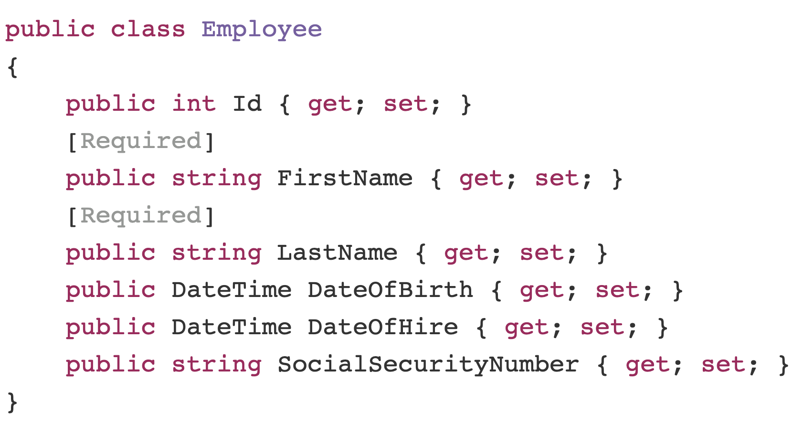

Slide 11
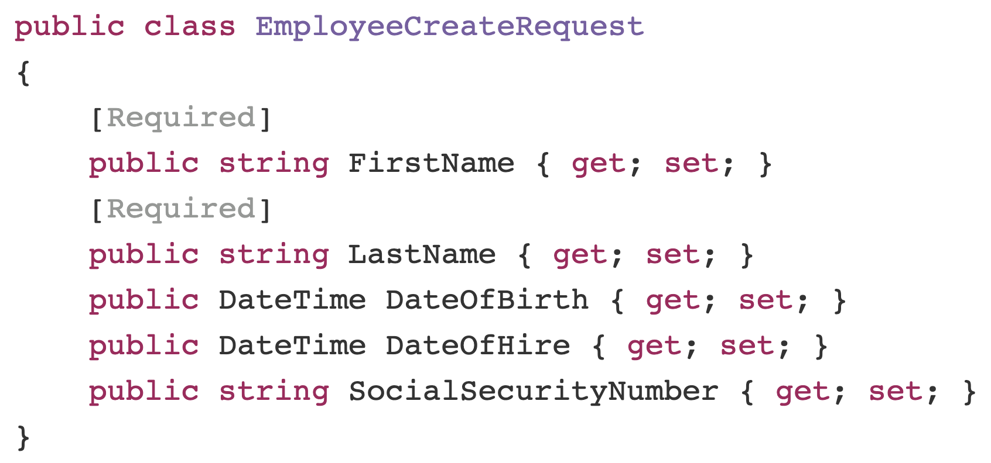

Slide 12
Next: the validator

Slide 14
FluentValidation

Slide 15
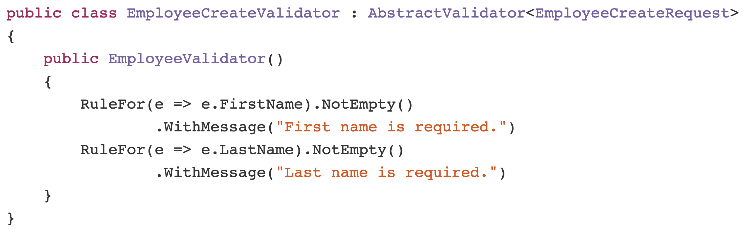

Slide 16
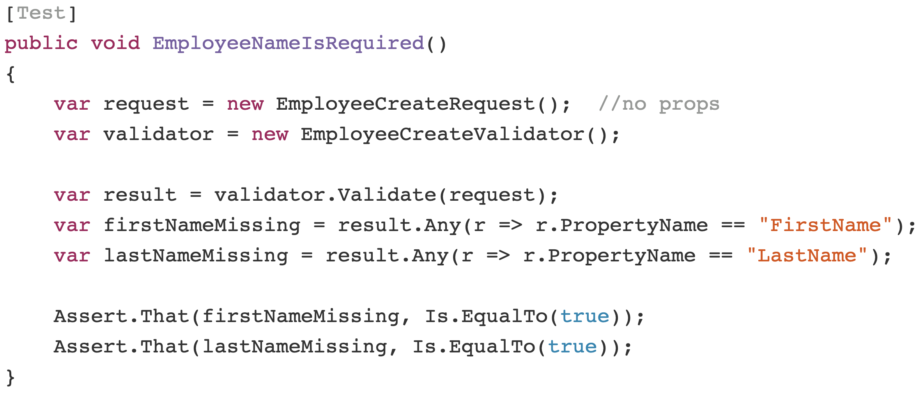

Slide 17
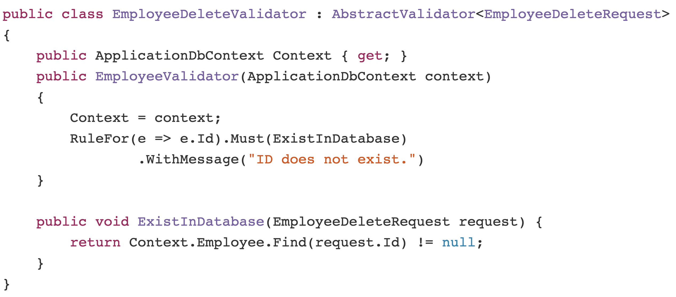

Slide 18
Next: the services

Slide 19
MediatR

Slide 20
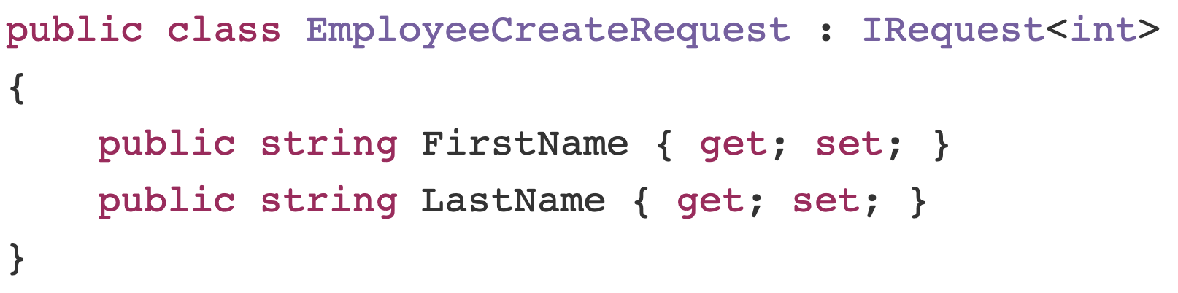

Slide 21
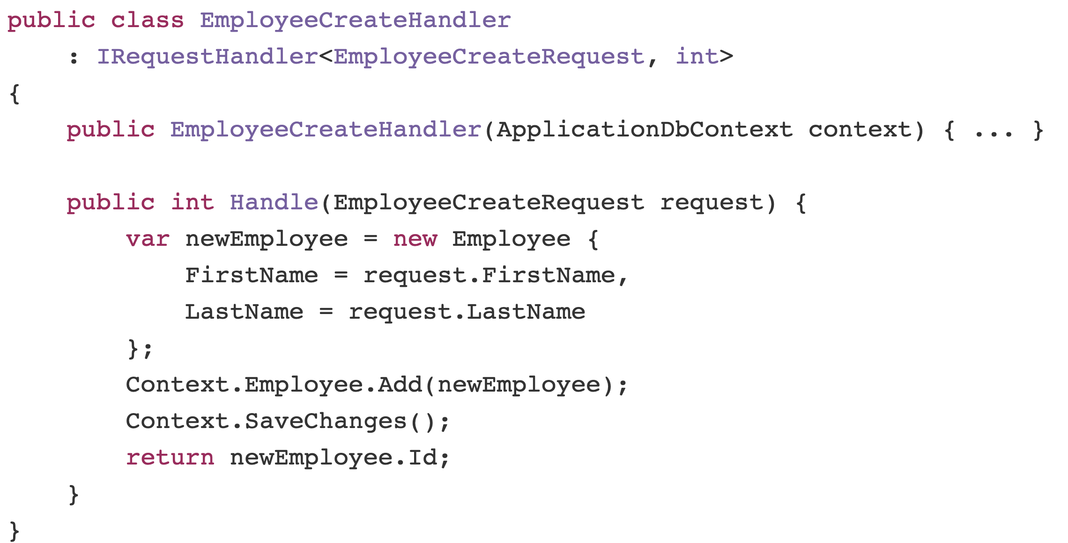

Slide 22
AutoMapper

Slide 23
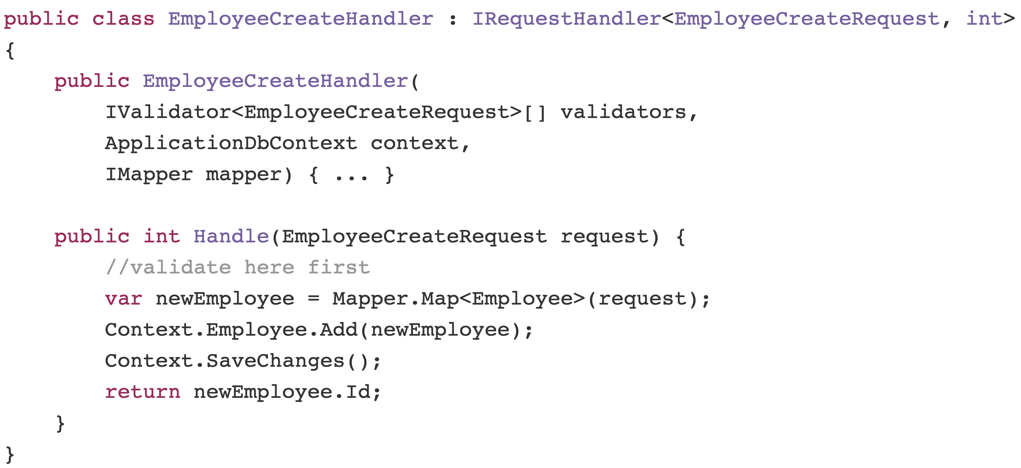

Slide 24
DI? Microsoft/Autofac Data? Entity Framework Core

